Slide 1

Crypto AnAyltics: Cryptocurrency Market Correlation Analysis
Subtitle: Understanding Bitcoin’s Influence on Altcoins Presented by: Ayberk Cansever & Anita Bhandari Course: CSCI/DASC 6010: Big Data Analytics and Management , Spring 2025 Date: 3/2/2025

Slide 2
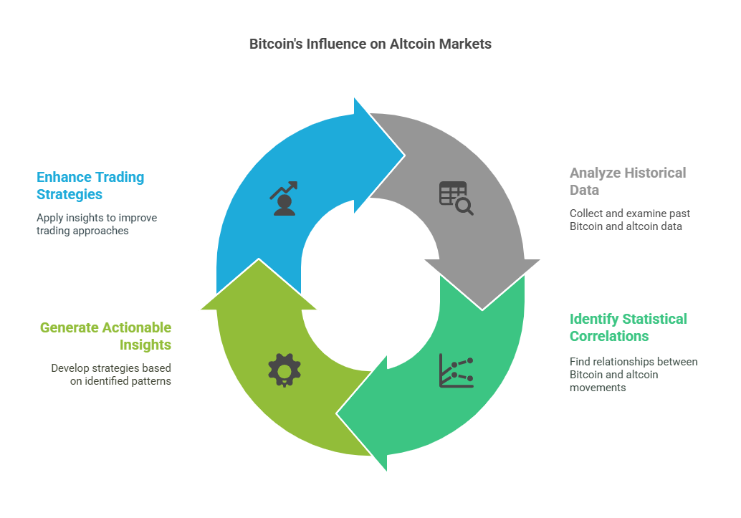
Crypto AnAyltics
This project aims to provide actionable insights into Bitcoin’s influence on altcoin markets, helping traders develop better strategies based on historical data and statistical correlations.

Slide 3
Problem Statement

Slide 4
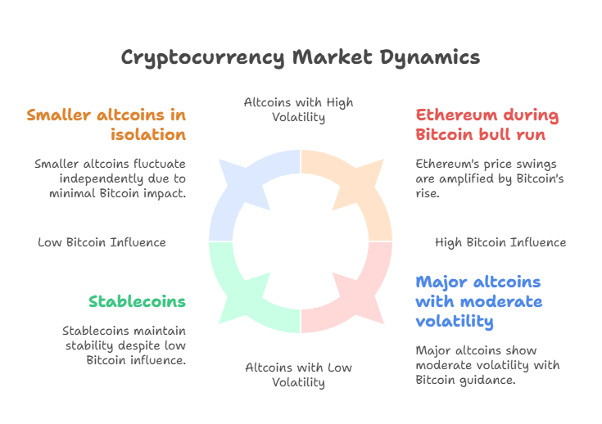
Cryptocurrency Market Volatility
Cryptocurrency markets are highly volatile, with prices frequently experiencing large fluctuations within short periods. While Bitcoin (BTC) is the dominant cryptocurrency, accounting for a significant portion of the total market capitalization, its price movements often influence the behavior of altcoins (alternative cryptocurrencies). This phenomenon is particularly evident during bull and bear markets, where Bitcoin's trends can dictate overall market sentiment.

Slide 5
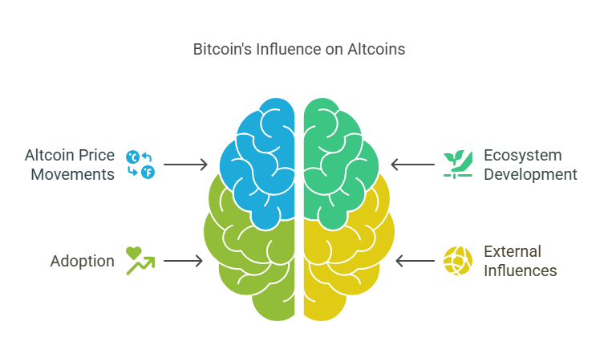
Bitcoin's Influence on Altcoins
Since Bitcoin is widely considered the "reserve currency" of the crypto market, many altcoins exhibit correlated price movements, reacting to BTC’s fluctuations in varying degrees. However, not all altcoins respond uniformly—some may move in tandem with BTC, while others exhibit more independent trends due to unique market factors such as ecosystem development, adoption, and external influences.

Slide 6
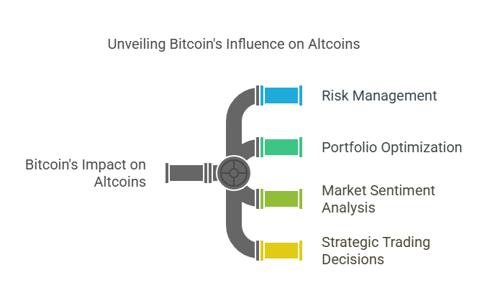
Importance
Understanding the correlation between Bitcoin and altcoins is crucial for:
Risk Management: Traders and investors can assess how altcoins move in relation to BTC, enabling them to hedge against market risks.
Portfolio Optimization: Identifying less-correlated assets allows for diversification, reducing exposure to single-asset volatility.
Market Sentiment Analysis: Bitcoin dominance (BTC’s market share relative to altcoins) serves as a key indicator of whether investors favor Bitcoin over altcoins in different market conditions.
Strategic Trading Decisions: High-correlation altcoins can be used for arbitrage strategies, while low-correlation ones can act as alternative investments in volatile periods.

Slide 7
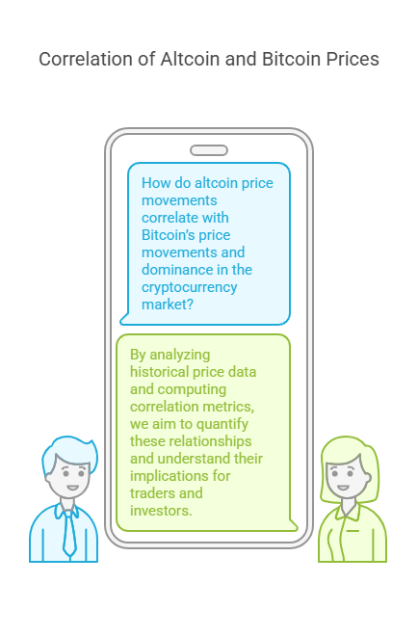
Research Question
This project seeks to answer the question: "How do altcoin price movements correlate with Bitcoin’s price movements and dominance in the cryptocurrency market?" By analyzing historical price data and computing correlation metrics, we aim to quantify these relationships and understand their implications for traders and investors.

Slide 8
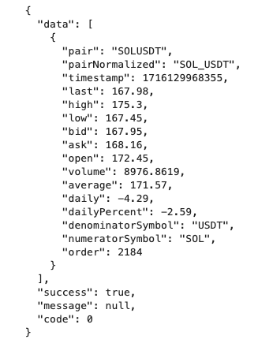
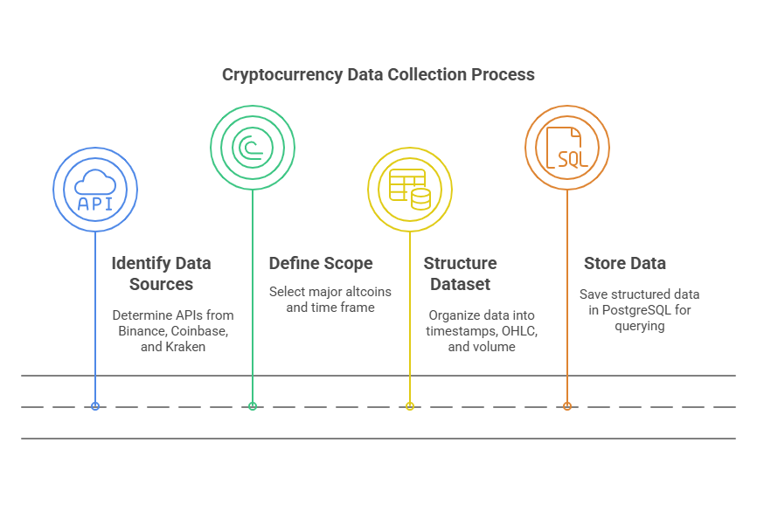
Data Collection & Description
Source: Fetching real-time and historical data from Binance public APIs.
Scope: Several major altcoins (ETH, BNB, ADA, SOL etc.) over 4 years.
Dataset Structure:
Timestamps (15-minute intervals)
OHLC (Open, High, Low, Close)
Volume
Storage: PostgreSQL for efficient querying & processing.

Slide 9
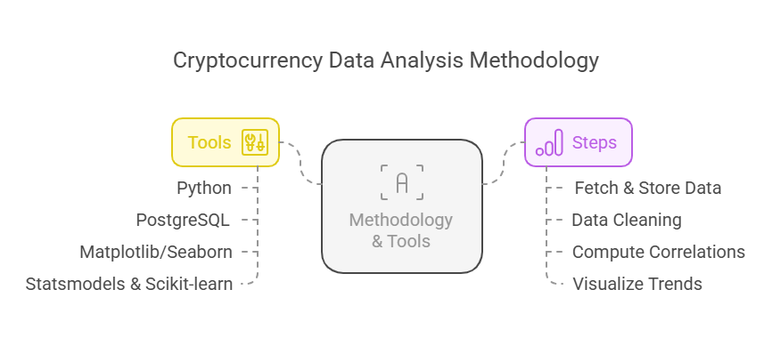
Tools
Python (Requests, Pandas, NumPy, SciPy)
PostgreSQL (for data storage)
Matplotlib/Seaborn (for visualization)
Statsmodels & Scikit-learn (for correlation analysis)
Steps
Fetch & store data in PostgreSQL.
Perform data cleaning if needed (handling NaNs, duplicates).
Compute correlation coefficients between BTC and altcoins.
Visualize trends and patterns.

Slide 10
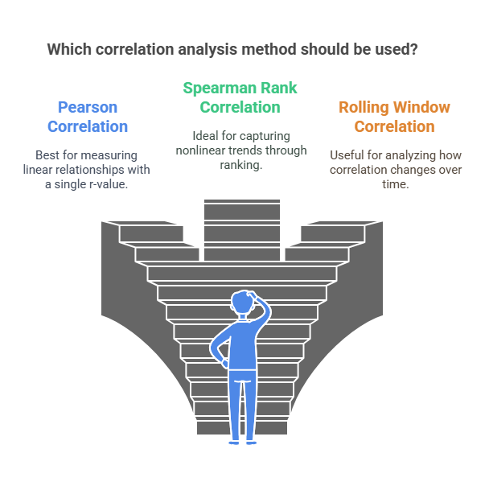
Correlation Analysis Approach
Statistical Approach:
Pearson Correlation: Measures linear relationship (r-value).
Spearman Rank Correlation: Captures nonlinear trends.
Rolling Window Correlation: How correlation changes over time.

Slide 11
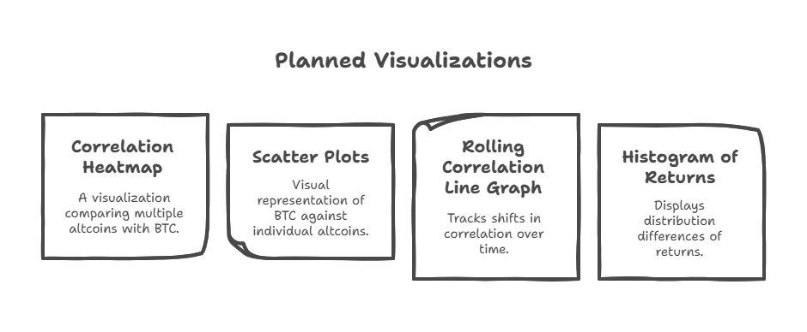
Planned Visualizations
Correlation Heatmap (to compare multiple altcoins with BTC).
Scatter Plots (visualizing BTC vs. individual altcoins).
Rolling Correlation Line Graph (tracking correlation shifts over time).
Histogram of Returns (to see distribution differences).

Slide 12
Hypothesis
Some altcoins (ETH, BNB) will be highly correlated with BTC.
Others (ADA, SOL) might be less correlated due to independent market drivers.
Use Case: Traders can use these correlations for hedging strategies and diversification.
Limitations:
Market sentiment & news events influence prices unpredictably.
External factors like regulations impact correlations.

Slide 13
K-Means Clustering: Group altcoins based on their correlation with BTC.
Goal:
• Group altcoins based on their historical correlation with Bitcoin (BTC).
• Identify clusters of cryptos that behave similarly to BTC.
Methodology:
• Standardize the correlation values for clustering.
• Apply K-Means Clustering with an optimal K value (number of clusters).
• Assign each altcoin to a cluster based on similarity in correlation patterns.
Expected Outcome:
• Cryptos grouped into highly correlated, moderately correlated, and independent movers.
• Insights on which altcoins react similarly to BTC price movements.
Key Takeaways:
• Helps traders diversify portfolios by selecting cryptos from different clusters according to the trend of crypto trend. (Take less risk when bearish and more risk when bullish)

Slide 14
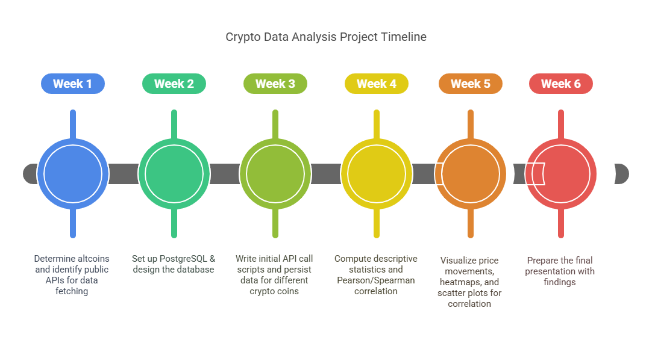
Where do you want to add if time permits planning to incorporate Machine learning?

Slide 15
Thank You!
🔹 We appreciate your time and attention! 🔹 This project aims to provide valuable insights into Bitcoin’s influence on altcoin markets through data-driven analysis. 🔹 We hope our findings help traders, investors, and researchers make informed decisions in the volatile crypto market.
💡 Questions? Let’s discuss!
📧 Contact: Ayberk Cansever & Anita Bhandari
💰 Happy Trading & Data Exploring! ₿📈

